Slide 1
Open Challenges
Steffen Bollmann
Research Fellow
School of Information Technology and Electrical Engineering

Slide 2
Labelling data for image segmentation is hard :/
Can we build a framework that makes this process easier?
Taking the human into the loop?
“Telling” the AI algorithm interactively what areas to segment in a large dataset without manually labelling hundreds of cases?

Slide 3
What exists already and why is it not good enough?

Slide 4
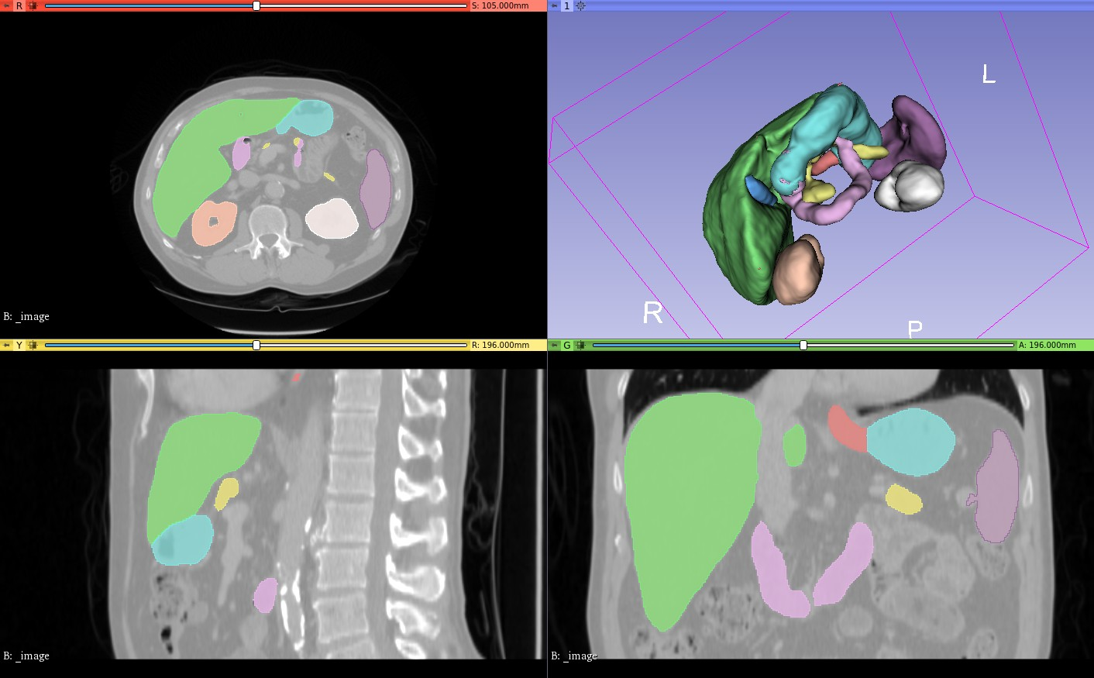
Nvidia AI-assisted annotation (AIAA) for 3D Slicer
https://github.com/NVIDIA/ai-assisted-annotation-client/tree/master/slicer-plugin

Slide 5
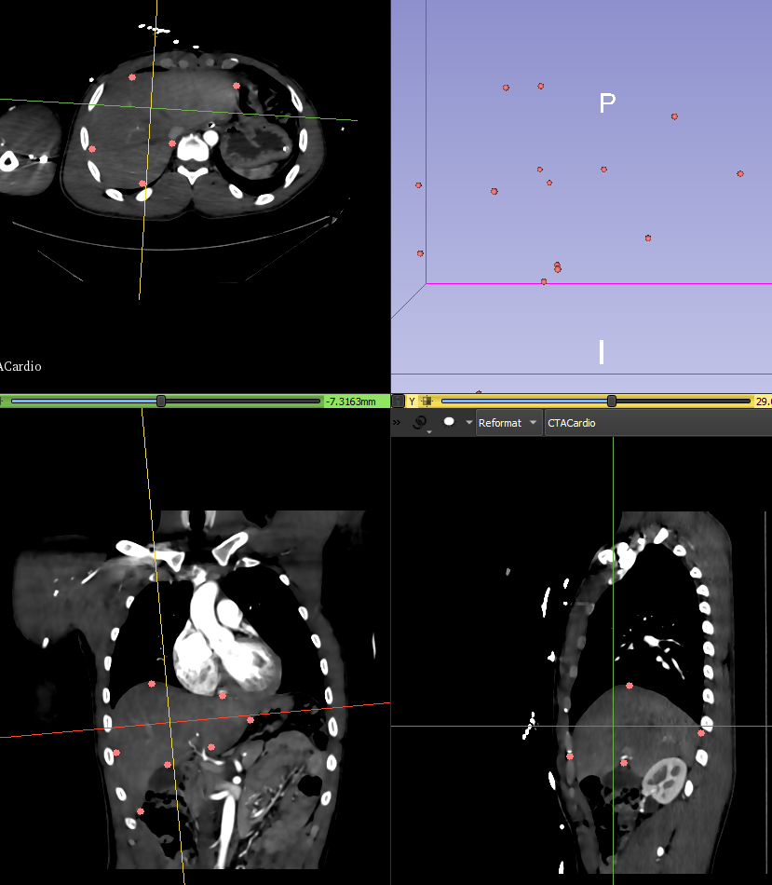
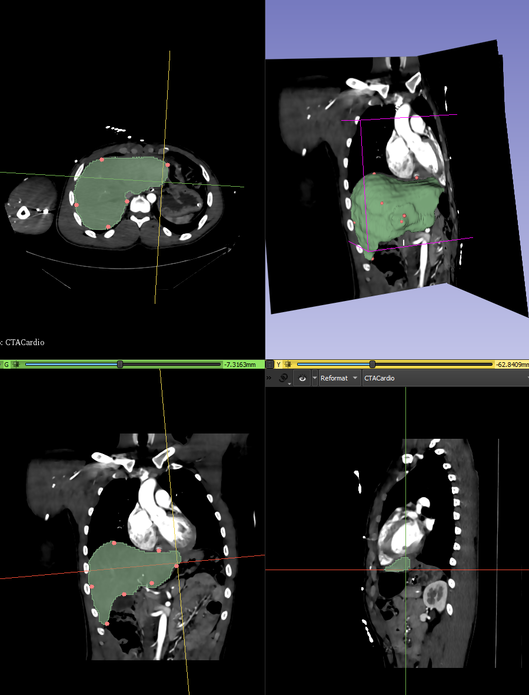
Marking organs with edge points -> only works for predefined organs ☹

Slide 6
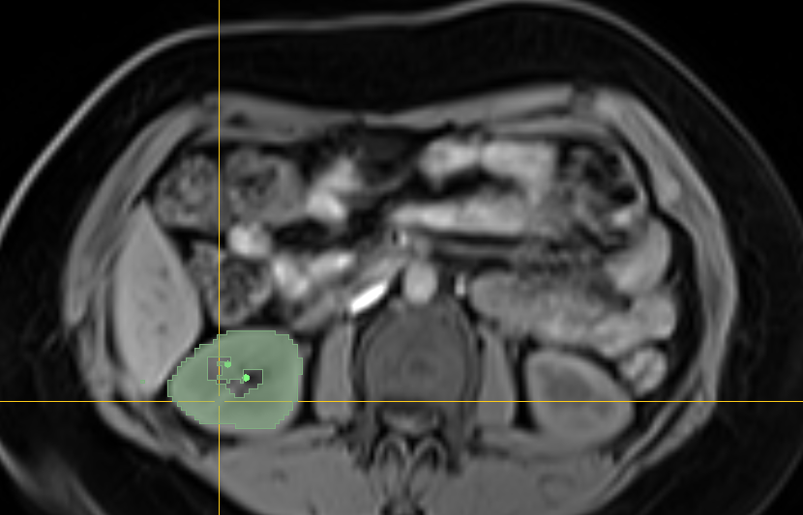
DeepGrow
Labour intensive
Not exploiting any dataset knowledge

Slide 7
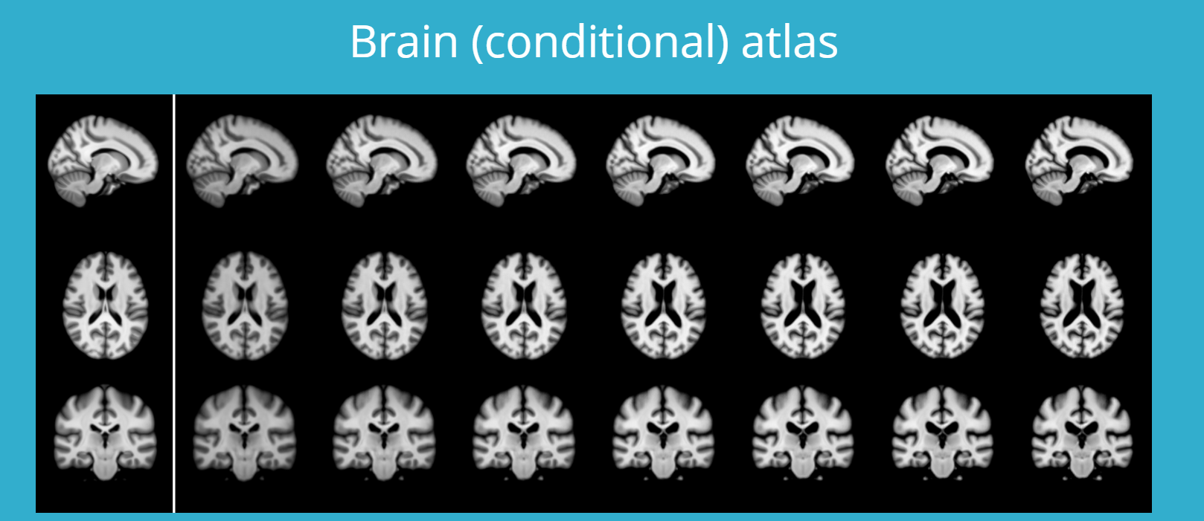
Let’s build up a statistical model of the existing data first and then ask the human for input
DATA: https://chaos.grand-challenge.org/Data/
IDEA: Register all data and build a “Template” representing the group anatomy -> Manually Segment template -> derive labels from this
Registration is time intensive – so let’s use deep learning for this:
https://github.com/voxelmorph/voxelmorph

Slide 8
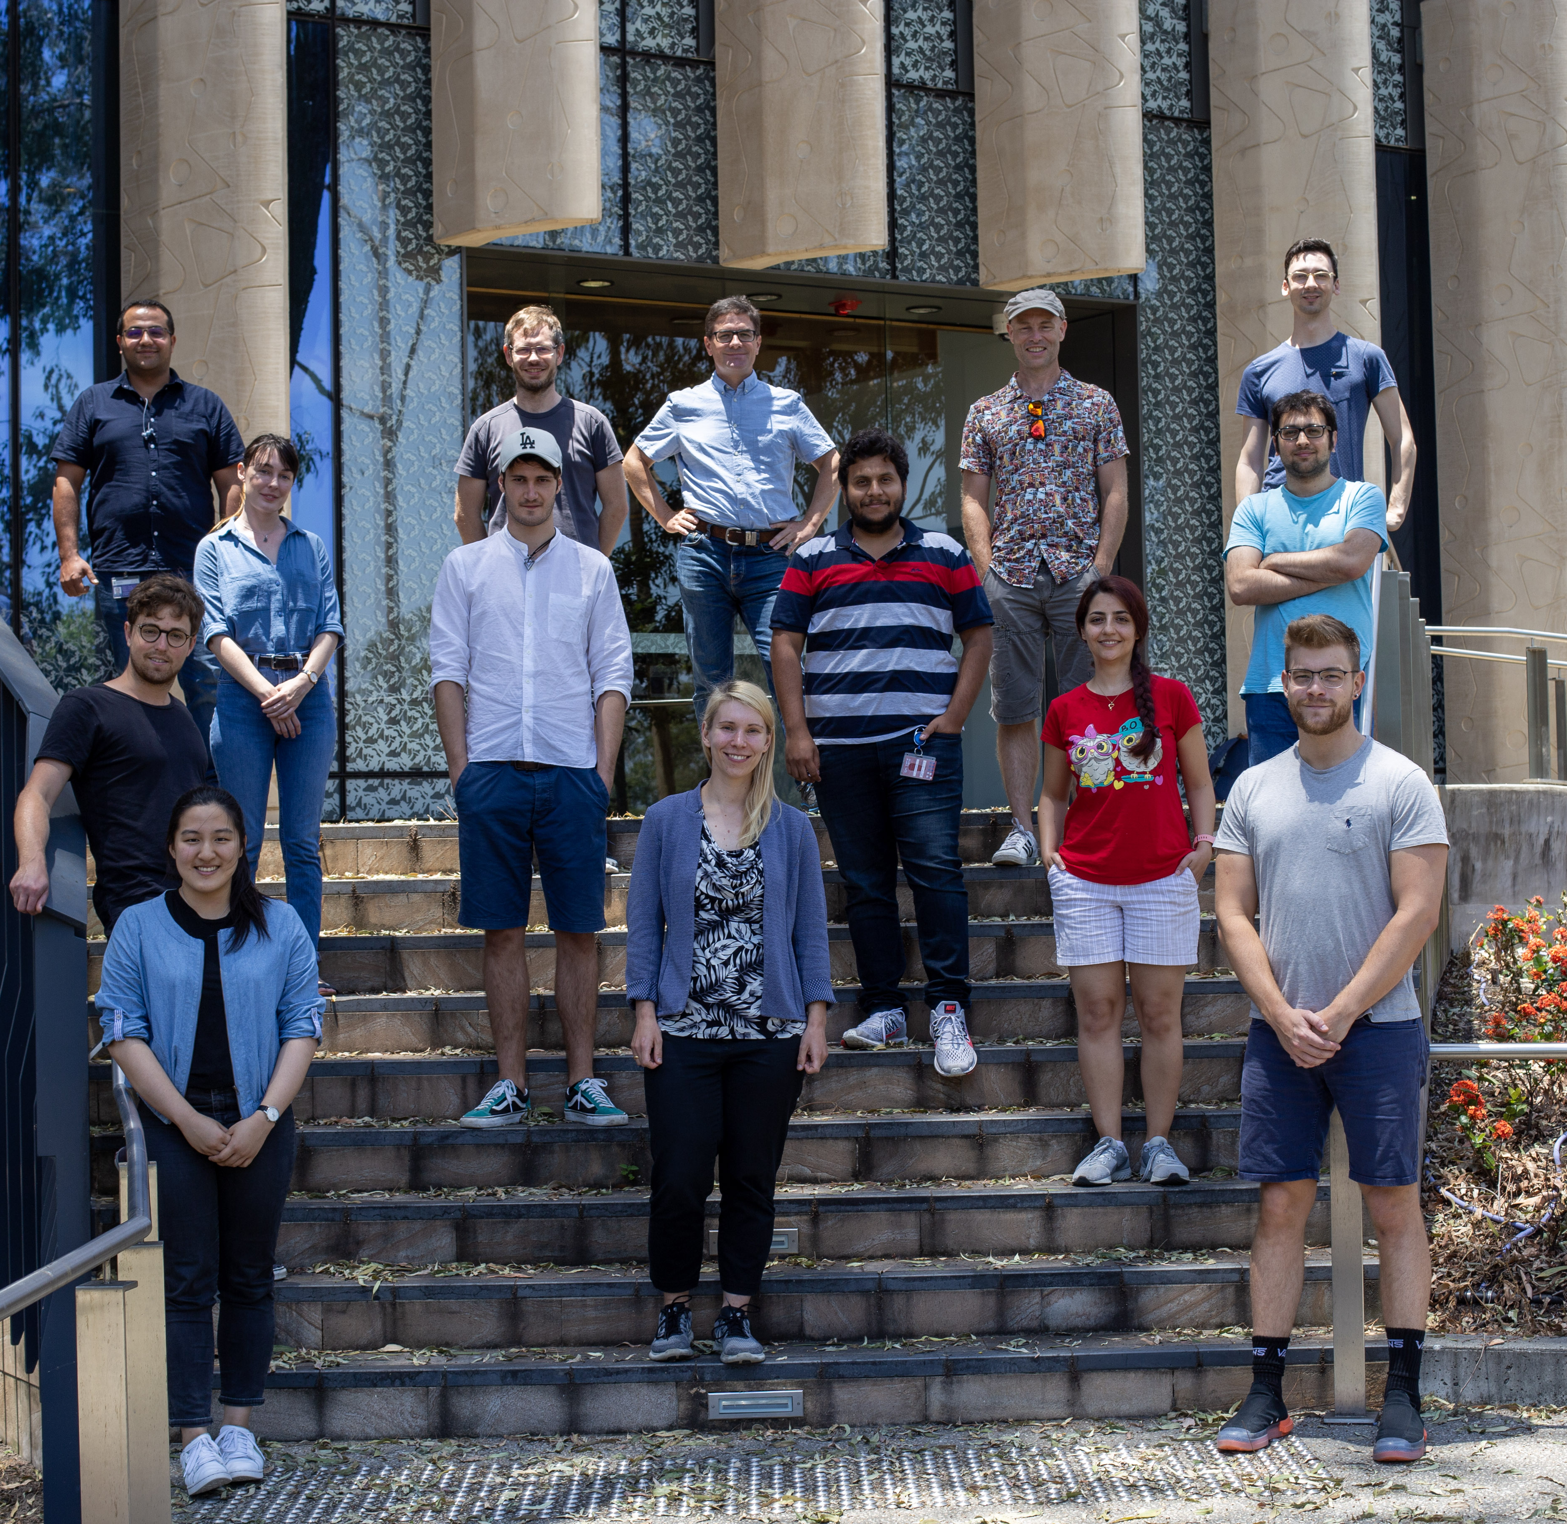




Thank you
s.bollmann@uq.edu.au
www.mri.sbollmann.net
@sbollmann_MRI
github.com/sbollmannmri

